Slide 1

Predicting Chronic Diseases Due To Diabetes

Slide 2
Contents
Abstract
Introduction
Literature Survey
Problem Statement
Objectives
System Requirements
Methodology
Results
Conclusion
References

Slide 3
Abstract
Developing countries such as India face a huge burden of diabetes and its complications. India is home to 77 million diabetic patients; it is the second highest in the world. Even children at the age of five are suffering from this disease. It is high time that people understand the gravity of the situation and make themselves fit to fight the disease than to suffer with it. If diabetes is not identified and treated in right time, it may lead to chronical health issues. Hence, as a part of this project a machine learning based prediction model is built to find the factors leading to complicated health issues such as cardio vascular disease. The project model will identify the attributes that highly contribute to cardio vascular disease and compare various machine learning algorithms to predict cardio vascular disease among diabetic patients. It identifies the best algorithm from a set of algorithms that best predicts the cardio vascular disease based on several performance metrics.

Slide 4
Introduction
Diabetes is a chronic disorder the world is suffering from.
Two-thirds of all people with diabetes live in urban areas.
Diabetes is increasing at alarming rate among Indians especially South Indians with prevalence of diabetes mellitus (PODM) varying in populations of different regions.
There is an urgent need to arrange several awareness programs in different parts of the country about symptoms of DM, factors causing it, medication, complications and its preventions etc.
It is important that people are extremely aware about the disorder, its symptoms and precautions to be taken to prevent the disorder.
It is important to identify the chronic diseases that a patient may suffer after being diagnosed with diabetes.
Machine learning models must be developed that identify the key attributes that highly effect the diabetic patients in acquiring chronic diseases.

Slide 5
Literature Survey
1) AI-based prediction for the risk of coronary heart disease among patients with type 2 diabetes mellitus[1]
It curated a dataset of 1,273 T2DM patients including 304 and 969 ones with or without CHD, respectively. It then trained an artificial intelligence (AI) model using randomly selected 4/5 of the dataset and used the rest data to validate the performance of the model.
The result showed that the model achieved an AUC of 0.77 (fivefold cross-validation) on the training dataset and 0.80 on the testing dataset. To further confirm the performance of the presented model, they recruited 1,253 new T2DM patients as totally independent testing dataset including 200 and 1,053 ones with or without CHD. And the model achieved an AUC of 0.71. In addition, They implemented a model to quantitatively evaluate the risk contribution of each feature, which is thus able to present personalized guidance for specific individuals. Finally, an online web server for the model was built.
This study presented an AI model to determine the risk of T2DM patients to develop to CHD, which has potential value in providing early warning personalized guidance of CHD risk for both T2DM patients and clinicians.
The used features in this study are limited
It is a binary class label data

Slide 6
Literature Survey[cont.,]
2) Early Prediction of Heart Disease Using the Most Significant Features of Diabetes by Machine Learning Techniques[2]
This paper aims to identify the association and common risk factors between diabetes and HD-this finding aid in anticipating the HD of a diabetic patient.
The authors use proven data mining approaches-logistics regression, decision tree, and random forest to arrive at the most accurate results. The validation is done using unsupervised method: K-means Clustering.
The initial investigation demonstrates that body-mass-index (BMI) and age are among the key risk factors for diabetes; and smoking habit, age, gender-male and diabetes (glucose level) lead to HD. 31% of diabetic patients had HD.
DT predicted better than any other method, i.e., 13.7% accurate in predicting HD, while RF predicted better than any other method, i.e., 13.7% accurate in predicting diabetes
Thus, no single method can be recommended in general
The data used is binary class label

Slide 7
Literature Survey[cont.,]
3) Supervised Machine Learning-Based Cardiovascular Disease Analysis and Prediction[3]
This study covers many aspects of cardiac illness, as well as a model based on supervised learning techniques such as Random Forest (RF), Decision Tree (DT), and Logistic Regression (LR).
It makes use of an existing dataset from the UCI Cleveland database of heart disease patients. There are 303 occurrences and 76 characteristics in the collection.
Only 14 of these 76 characteristics are evaluated for testing, which is necessary to validate the performance of various methods.
The purpose of this study is to forecast the likelihood of individuals getting heart disease. The findings show that logistic regression achieves the best accuracy score (92.10%).
Target label is a binary label
Not many algorithms are used for comparison
Only used for Cardiovascular Disease but not on exclusively on diabetic patients.

Slide 8
Literature Survey[cont.,]
4) Diabetes & Heart Disease Prediction Using Machine Learning [4]
The papers presented a novel method for identifying significant features using machine learning techniques, which improves the diagnosis of multi-purpose disease prediction. The different features and many well-known classification methods are used to implement the prediction model to predict the heart disease and diabetes.
The proposed method utilized ensemble approach for achieving a higher degree of accuracy rates for by using classification algorithms and feature selection methods.
The proposed method implements voting classifier that has sigmoid SVC, AdaBoost, and Decision tree algorithms. The paper also implements the traditional classifiers and presents the comparison of different models in terms of accuracy.
For heart disease, it is concluded that the Voting Classifier of Decision Tree, Sigmoid SVC, and Adaboost has the highest accuracy of 88.57 % and for diabetes, the voting classifier has an accuracy of 80.95 %.
The dataset used is binary class labeled.
The paper does not speak of risk of cardio vascular disease among diabetic people.

Slide 9
Literature Survey[cont.,]
5) A Method for Improving Prediction of Human Heart Disease Using Machine Learning Algorithms[5]
It identified and predicted human heart disease using a variety of machine learning algorithms and used the heart disease dataset to evaluate its performance using different metrics for evaluation, such as sensitivity, specificity, F-measure, and classification accuracy.
For this purpose, it used nine classifiers of machine learning to the final dataset before and after the hyperparameter tuning of the machine learning classifiers, such as AB, LR, ET, MNB, CART, SVM, LDA, RF, and XGB.
Furthermore, it checked their accuracy on the standard heart disease dataset by performing certain preprocessing, standardization of dataset, and hyperparameter tuning.
Highest accuracy of 96.72% is achieved by SVM.
The dataset used is binary class labeled.
The paper does not speak of risk of cardio vascular disease among diabetic people.

Slide 10
Problem statement
People all over the world are subjected to various diseases and disorders in which diabetes is one of them. Approximately 537 million adults (20-79 years) are living with diabetes which is 10.5 percent of global adult population. As mentioned in the Literature Survey there are not many projects focussing on chronic diseases due to diabetes and even if such projects are found in cardio vascular disease, they are of binary class label which focus on one or two algorithms. We in this project aim at developing a model that is based on multi class labelled data and focusses on comparing various algorithms to find the best algorithm. We also aim at finding the attributes that highly contribute to cardio vascular disease.

Slide 11
Objectives
To find the attributes that highly effect chronic disease due to diabetes.
To build various machine learning models and compare them to identify the model that performs best on the given data.

Slide 12
System Requirements
Hardware Specification
Processor 11th Gen Intel(R) Core(TM) i5-1135G7 @ 2.40GHz 2.40 GHz
Installed RAM 8.00 GB (7.65 GB usable)
System type 64-bit operating system, x64-based processor
Software Specification
Python version 3.x

Slide 13
Methodology
To train the model, dataset is collected from UCI and 14 key attributes are considered for cardiovascular disease prediction.
Pre-processing is applied to eliminate missing values from the dataset
Feature extraction is performed on the data by using ExtraTreeClassifier and the feature with highest relevance is obtained and a graph is drawn between the score and the attributes.
The dataset is split into training set and test set with 70% and 30% proportions respectively.
Classification is performed using K-NN with k=13 , Decision Tree with gini index, Decision Tree with entropy, Random Forest, Naïve Bayes and Gradient Boosting.
The trained model is tested on the test set to predict for various algorithms mentioned above and their performance is evaluated.
The performance metrics used include accuracy, precision, recall, F1 score, train time, test time and confusion matrix.
The performance metrics of all the algorithms are obtained in the form of a table for comparison.
Graphs are obtained for performance metrics vs algorithms.

Slide 14
Results
Environment: 11th Gen Intel(R) Core(TM) i5-1135G7 processor is used with 8GB RAM and 64-bit operating system. The software used is python of version 3.x.
UCI dataset with 14 attributes is used. The "label" field refers to the presence of heart disease in the patient. It is integer valued from 0 (no presence) to 4. The data is in the form of .data file.
One of the attribute is fasting blood sugar which is the criterion for filtering diabetic data.
The remaining 13 attributes include age, sex, chest pain type, resting blood pressure, serum cholesterol, resting electrocardiographic results, max heart rate achieved, exercise induced angina, ST depression induced by exercise relative to rest, slope of peak exercise ST segment, number of major vessels coloured by fluoroscopy, thalassaemia and label.
After filtering the null values from the dataset we obtained 43 diabetic people.

Slide 15
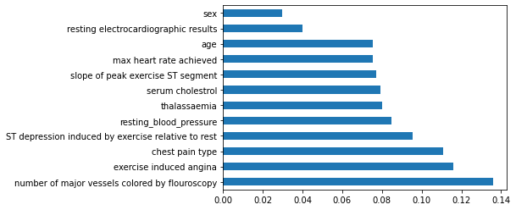
Results [cont.,]
We performed feature selection using ExtraTreeClassifier and obtained the following result:
Various classification algorithms are used to train the model and test it.
Fig 1: Feature selection using ExtraTreeClassifier

Slide 16
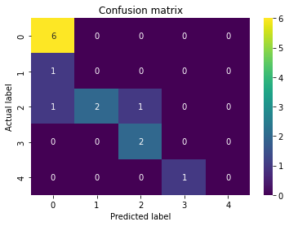
Results [cont.,] Algorithm 1: KNN
Import KNeighborsClassifier from sklearn library
Split the dataset into 70% for training and 30% for testing
For k from 1 to 25, fit the model and compare the model score to identify the k that gives the highest score.
By using the obtained k, test the model and apply performance metrics for further analysis.
Performance metrics obtained:
Accuracy: 69%
Precision: 0.56
Recall: 0.69
F1 Score: 0.59
Train Time: 0.00299 seconds
Test Time: 0.00444 seconds
Fig: 2 Confusion matrix of KNN with k = 13

Slide 17
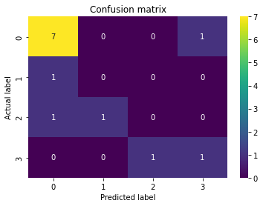
Results [cont.,] Algorithm 2: Decision Tree with Gini Index
Import DecisionTreeClassifier from sklearn library
Split the dataset into 70% for training and 30% for testing
The gini index criterion is by default available for DecisionTreeClassifier
Train the model with 70% of the data and calculate the time taken to train.
Test the model with 30% of the data and calculate the time taken to test.
Apply performance metrics for further analysis.
Use the trained model to obtain the decision tree with Gini index as the split criteria.
Performance metrics obtained:
Accuracy: 61%
Precision: 0.55
Recall: 0.61
F1 Score: 0.58
Train Time: 0.00273 seconds
Test Time: 0.00148 seconds
Fig 3: Confusion matrix for decision tree classifier with Gini index obtained

Slide 18
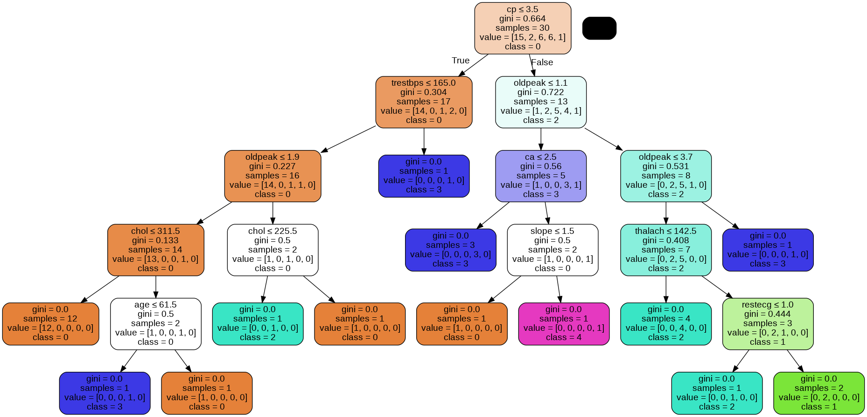
Results [cont.,] Algorithm 2: Decision Tree with Gini Index [cont.,]
Fig 4: Decision Tree with Gini Index as the splitting criterion

Slide 19
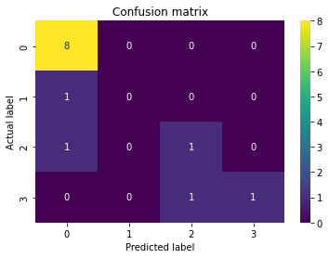
Results [cont.,] Algorithm 3: Decision Tree with Entropy
Import DecisionTreeClassifier from sklearn library
Split the dataset into 70% for training and 30% for testing
Make the criterion as entropy in DecisionTreeClassifier.
Train the model with 70% of the data and calculate the time taken to train.
Test the model with 30% of the data and calculate the time taken to test.
Apply performance metrics for further analysis.
Use the trained model to obtain the decision tree with Gini index as the split criteria.
Performance metrics obtained:
Accuracy: 76.9%
Precision: 0.72
Recall: 0.769
F1 Score: 0.72
Train Time: 0.00412 seconds
Test Time: 0.00210 seconds
Fig 5: Confusion matrix for decision tree with Entropy obtained

Slide 20
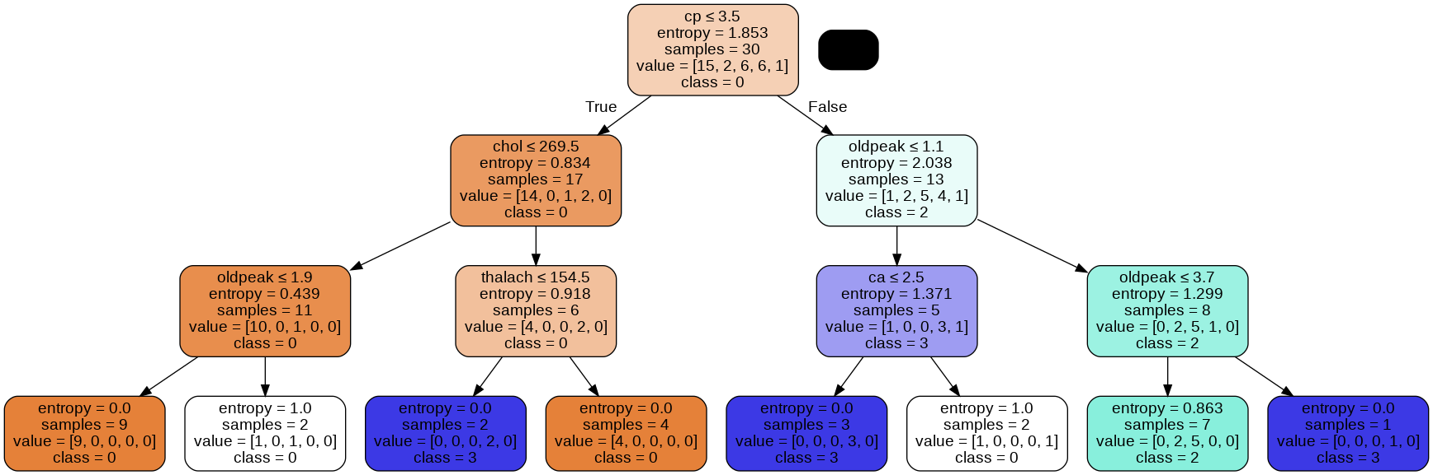
Results [cont.,] Algorithm 3: Decision Tree with Entropy [cont.,]
Fig 6: Decision Tree with Entropy as the splitting criterion

Slide 21
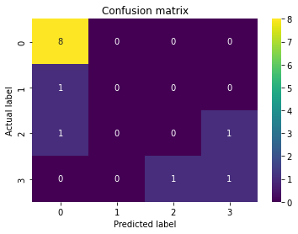
Results [cont.,] Algorithm 4: Random Forest
Import RandomForestClassifier from sklearn library
Split the dataset into 70% for training and 30% for testing
Initialize model with a max depth of 3.
Train the model with 70% of the data and calculate the time taken to train.
Test the model with 30% of the data and calculate the time taken to test.
Apply performance metrics for further analysis.
Performance metrics obtained:
Accuracy: 69%
Precision: 0.57
Recall: 0.69
F1 Score: 0.62
Train Time: 0.14051
Test Time: 0.01107
Fig 7: Confusion matrix for Random Forest obtained

Slide 22
Results [cont.,] Algorithm 5: Naïve Bayes
Import GaussianNB from sklearn library
Split the dataset into 70% for training and 30% for testing
Train the model with 70% of the data and calculate the time taken to train.
Test the model with 30% of the data and calculate the time taken to test.
Apply performance metrics for further analysis.
Performance metrics obtained:
Accuracy: 69%
Precision: 0.60
Recall: 0.69
F1 Score: 0.64
Train Time: 0.00365 seconds
Test Time: 0.00276 seconds
Fig 8: Confusion matrix for Naïve Bayes obtained

Slide 23
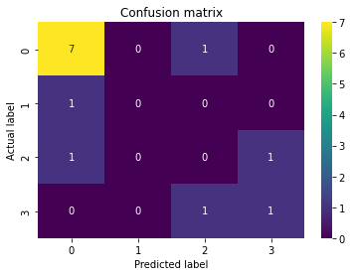
Results [cont.,] Algorithm 6: Gradient Boosting
Import GradientBoostingClassifier from sklearn library
Split the dataset into 70% for training and 30% for testing
Train the model with 70% of the data and calculate the time taken to train.
Test the model with 30% of the data and calculate the time taken to test.
Apply performance metrics for further analysis.
Performance metrics obtained:
Accuracy: 61%
Precision: 0.55
Recall: 0.61
F1 Score: 0.58
Train Time: 0.45681 seconds
Test Time: 0.00245 seconds
Fig 9: Confusion matrix for Gradient Boosting obtained

Slide 24




Results [cont.,]
Performance Metrics:
Accuracy: Accuracy is the fraction of predictions our model got right out of all the predictions. Decision Tree with Entropy has the highest precision whereas Decision Tree with Gini index and Gradient Boosting have the least precision.
Precision: Precision tells what proportion of positive predictions was actually correct.
Recall: Recall aims at measuring what proportion of actual positives was identified correctly.
F1 Score: The F1 score is a less known performance metric, indicating the harmonic mean of Precision and Recall.

Slide 25
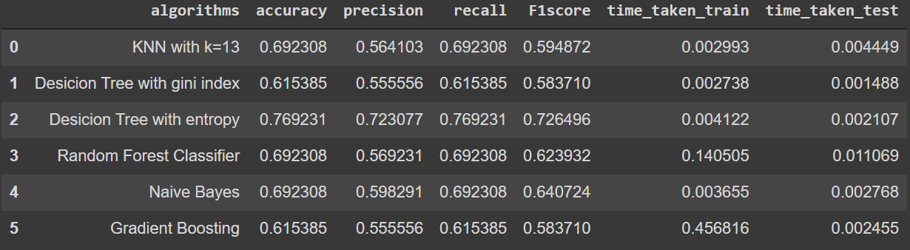
Results [cont.,]
After comparing the performance of various algorithms as shown in the figure given below, decision tree with entropy is identified to have highest accuracy of 76.9%.
Fig 10: Comparison of performance metrics of various algorithms

Slide 26
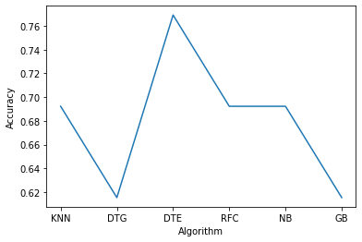
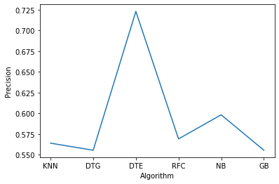
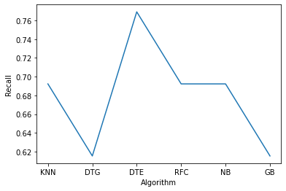
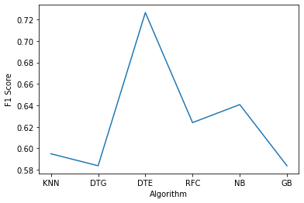
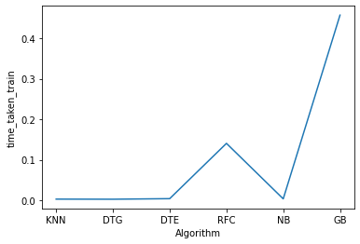
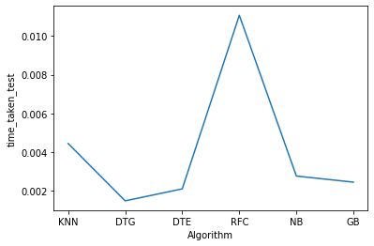
Results [cont.,]
Graphs for performance metrics vs algorithms are shown below:
Fig 11-16: Accuracy, Precision, Recall, F1Score, Time taken to train model, Time taken to test model vs Algorithms

Slide 27
Results [cont.,]
According to the above graphs:
The Decision Tree Algorithm with entropy as the split criterion has the highest accuracy whereas Decision Tree with Gini index as the split criterion and Gradient Boosting algorithms have the least accuracy respectively.
Decision Tree with Entropy has the highest precision whereas Decision Tree with Gini index and Gradient Boosting have the least precision.
Decision Tree with Entropy has the highest recall whereas Decision Tree with Gini index and Gradient Boosting have the least recall.
Decision Tree with Entropy has the highest F1 Score whereas Decision Tree with Gini index and Gradient Boosting have the least F1 Score.
Decision Tree with Entropy, KNN, Decision tree with Gini index and Naïve Bayes have the least time taken to train the model whereas Gradient Boosting has taken the highest time taken to train the model among the algorithms use.
Decision Tree with Gini index has the least time taken to test the model, followed by Decision Tree with Entropy whereas Random Forest Classifier has taken the highest time taken to test the model among all the algorithms used.

Slide 28
Conclusion
Diabetes is a disorder that is very hard to cure and once diagnosed there is a high risk of being subjected to chronic diseases. At this dire situation proper methodologies must be developed to identify the attributes that highly effect the risk of acquiring these chronic diseases. We in this project focused on cardio vascular disease and identified that number of major vessels coloured by fluoroscopy, exercised induced angina and chest pain type were highly contributing to cardio vascular disease among diabetic patients. We also used various machine learning algorithms such as KNN, Decision Tree, Random Forest, Naïve Bayes and Gradient Boosting for classification and prediction. We compared the algorithms based on the performance metrics such as accuracy, precision, recall, F1 score, time taken to train and time taken to test. We identified that Decision Tree with entropy as the split criterion achieved the highest accuracy of 76.9%. We also visualised performance metrics vs algorithms to better analyse the algorithms. In future this project can be extended to include much more efficient algorithms since the algorithms used in this project are traditional ones. The project can include a better dataset with more number of diabetic patients for study, since this project only included less than 50 diabetic people for study. The project can be extended to group patients by using unsupervised learning methods to analyse the data further. More feature analysis methods can be used to identify the highly contributing parameters.

Slide 29
References
[1] https://www.nature.com/articles/s41598-020-71321-2, WHO Global Report. Global Report on Diabetes. Isbn 978, 6–86.
[2]https://www.researchgate.net/publication/351437170_Early_Prediction_of_Heart_ Disease_Using_the_Most_Significant_Features_of_Diabetes_by_Machine_Learning_ Techniques
[3]https://www.hindawi.com/journals/mpe/2021/1792201/, M. Durairaj and V. Revathi, “Prediction of Heart Disease Using Back Propagation MLP Algorithm,” ‘Information Communication and Embedded Systems, vol. 4, no. 08, pp. 235–239, 2015. [4]https://www.itmconferences.org/articles/itmconf/pdf/2022/04/itmconf_icacc2022_ 03057.pdf BhaveshDhande1 ,Kartik Bamble2 ,Sahil Chavan3 ,Tabassum Maktum4 1,2,3,4Ramrao Adik Institute of Technology, D Y Patil Deemed to be University, Navi Mumbai, India
[5]https://www.hindawi.com/journals/misy/2022/1410169/ L. A. Allen, L. W. Stevenson, K. L. Grady et al., “Decision making in advanced heart failure: a scientific statement from the American heart association,” Circulation, vol. 125, no. 15, pp. 1928–1952, 2
[6]https://towardsdatascience.com/performance-metrics-in-machine-learning-part-1- classification-6c6b8d8a8c92 Eugenio Zuccarelli Data Scientist for Fortune 100 | Fulbright Scholar | MIT '20, Harvard, Imperial College

Slide 30
THANK YOU

